Slide 1
205 Oct 23
Assefi & Garry (2003)
Chapter 11: Sampling and Generalizability

Slide 2
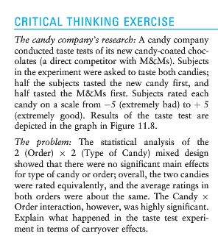
Taste test

Slide 3
Order effects in within-participants design
In a simple 2 group within-participants study, participants complete both conditions of the experiment, order counterbalanced
  A versus B
If order substantially affects the DV, the design has accidentally become a mixed-model 2x2
  Factor 1: A, B
  Factor 2: Order 1 (X), Order 2 (Y)
Observing an interaction complicates the inference

Slide 4
Types of 2x2 designs
Two manipulated factors, between participants
  Experimenter assigns participants to one of the four conditions
One manipulated factor, one participant variable
  Measure or recruit based on participant variable
    Split into 2 groups by median or pre-defined criterion
  Random assignment across manipulated factor
Two within-participant factors
  Participants each do all four conditions, counterbalanced order
One within-participant factor, Repeated Measures
  Participants randomly assigned to AX,AY or BX,BY
    Order counterbalanced
  Mixed-model design

Slide 5
Absolut Memory Distortions
Can the simple suggestion that you have consumed alcohol affect your memory for an event? Alcohol placebos affect social behaviors, but not non-social ones, and have not previously been shown to affect memory. We investigated the effect of alcohol placebos using materials that revealed both the social and the nonsocial influences of memory. Subjects drank plain tonic water, but half were told it was a vodka and tonic; then all subjects took part in an eyewitness memory experiment. Subjects who were told they drank alcohol were more swayed by misleading postevent information than were those who were told they drank tonic water, and were also more confident about the accuracy of their responses. Our results show that the mere suggestion of alcohol consumption may make subjects more susceptible to misleading information and inappropriately confident. These results also provide additional confirmation that eyewitness memory is influenced by both nonsocial and social factors.

Slide 6
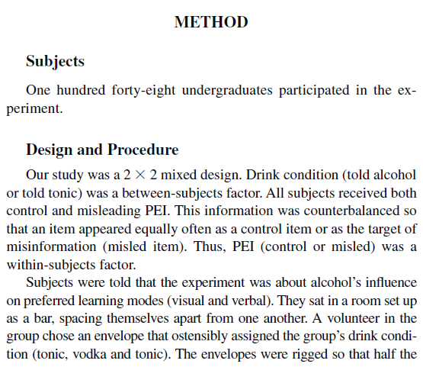
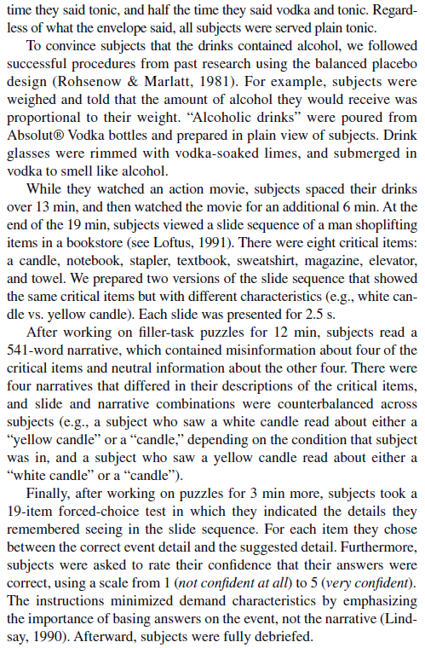

Slide 7
Assignment questions
What are the two factors and levels of each factor in the design?
What is the main dependent variable of the design?
What are the 3 hypotheses tested by this factorial design?
What kind of interaction is shown in Figure 1?

Slide 8
Diagram
2x2 mixed design
  Placebo/control between groups
  Misleading/control information within groups
148 original participants (31 eliminated)
  74 subjects per group planned
 | Misleading PEI | Control PEI
Alcohol placebo | N=74 1.45 | N=74 2.45
Control | N=74 1.80 | N=74 2.50

Slide 9
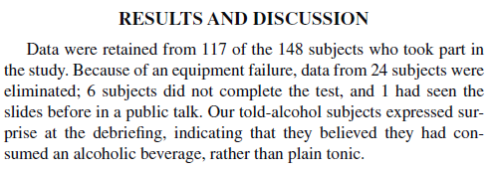
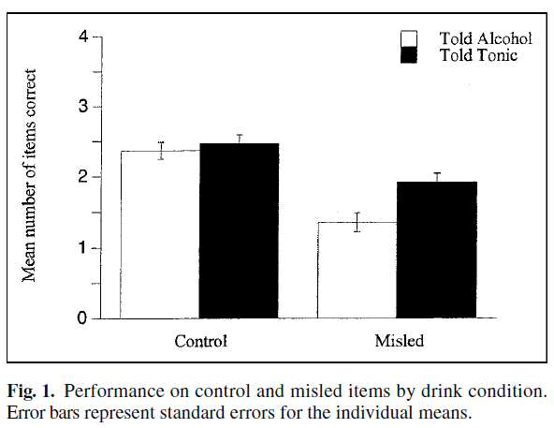

Slide 10
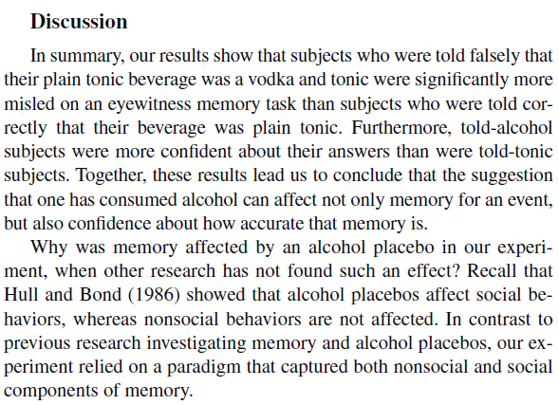

Slide 11
Research sampling
Terms
  Sample: participants, the people who actually participated in your study
  Population: the general collection your participants were drawn from
Statistics
  Measurements of your sample are noisy estimates of what you would get from measuring everybody in your population
  Mean, SD are population descriptions
  SE, Standard Error, is estimate of accuracy of your sample measurements

Slide 12
Recruiting participants
Convenience sampling
  Collecting data from available people around you
University undergraduates
  Course credit for participation, 3-10 hours
Paid participants
  Departmental PPR: Paid Participant Registry
    Mailing list of participants who expressed interest in participation opportunities
  Posted flyers around campus
  Paid ads
Other online sources: Mechanical Turk, Prolific

Slide 13
Ethics in Research Advertising
All recruiting materials must be reviewed by the IRB
  All posted flyers should have an approval stamp
Accuracy of description
  What if the experiment includes some deception?
  Ad is necessarily shorter than a consent form
Compensation and coercion
  Paying too much is a concern
  Competition among researchers discouraged
    But no published standard guidelines exist

Slide 14
Coercion in recruiting
No participant in a research study should ever feel threatened into participating
  Loss of employment concerns
    Lab staff members cannot be recruited
  Loss of educational access
  Loss of medical benefits access
Studies with substantial risk often pay more
  Concerns about implicit coercion of poor participants
  IRB judges the balance of risk/compensation

Slide 15
External validity
Are we confident that the results of the findings with the sample apply to the whole population?
Internal validity
  Are we confident the IV is responsible for the DV effect we measured?
Experimental research: excellent internal, mediocre external
Non-experimental research: weak internal, excellent external

Slide 16
Sampling bias
Could the recruiting method lead to a non-representative sample?
  Recruiting by ad
    “Do you like puzzles?”
    “Research on stereotypes and bias”
    “Study on memory!”
    Brain imaging, EEG...
If the sample is biased
  Internal validity stays high
  External validity may be limited

Slide 17
Limitations on external validity
The research results may not apply to the whole population
  They still apply to similar samples (restricted population)
  Who doesn’t it apply to?
    Why?
Implicit limitations
  Effects rarely assumed to apply across whole age range
  Not assumed to apply to constrained subpopulations
What sampling issues do we have to consider with our in-class experiment methodology?

Slide 18
WEIRD Samples
Western
Educated
Industrialized
Rich
Democratic
Undergraduates from expensive universities in the USA, Canada, Western Europe
When does this subpopulation exhibit different psychological phenomena than the broader population?

Slide 19
In-class research
What sampling issues do we have to consider with our methodology for the in-class Experiment 1 and Experiment 2?

Slide 20
Online research
Online marketplace to connect volunteers to researchers
  Potential to be less WEIRD
  Still somewhat restricted
Not well-integrated into oversight processes for research
  Identity authentication is hard
  Bots, multi-accounts, shared accounts
  Little accountability for researchers about privacy, compensation, fairness
Practically seems to work very well
  No major issues seem to have occurred to date

Slide 21
For Friday Oct 25
Handbook/recipe for running ANOVA in R posted on Canvas
Collect data for Experiment 2
  Analysis on Monday 10/28

